Slide 1

GhostWire
The #1 Solution to Racist AI
by Team HD_Please
Notes:
Aaron:
- Rhetorical Question on AI:
"If AI no rules, what happens to life?"
- Greet teacher, TAs, classmates
- Introduce team and product
- Introduce teammates
Note: Play in presentation mode, transitions have been adjusted accordingly to ensure that information is not cluttered on page and is displayed one by one
Thank you

Slide 2

Meet the Team
Chloe
Secretary
Ui/UX designer
Shayan
Team Lead
Ui/Ux Designer
Aaron
Product Owner
Daryl
QA tester
Brand
Programmer
Khang Wei
Programmer
Notes:
Everyone:
Introduce themselves and their role

Slide 3
Contents Page

Slide 4

Contents
Background & Problem Statement
Proposed Solution
Feature
Pseudocode
Persona and Scenario
Demo of Prototype
Conclusion
Q&A
Notes:
Background & P.S. - Daryl
Proposed Solution - Khang Wei, Brand, Aaron
Demo - Shayan
Conclusion - Chloe
Q&A

Slide 5
Background & Problem Statement

Slide 6
Background: Technical and Ethical Issues in AI Chatbots
Ethical | Technical
Social Impact: Potential to normalize harmful behaviors online | Algorithmic Bias: AI algorithms may reflect existing societal biases
Lack of Ethical Reasoning: AI chatbots lack the ability to make ethical decisions | Training Data Issues: Insufficient filters to moderate inappropriate material
Real-World Consequences: Impact on vulnerable populations, worsening inequalities | Manipulation Risk: Potential for generating harmful or offensive content
Notes:
Daryl:
To give a brief rundown of the issues concerning AI chatbots:
AI chatbots poses significant ethical concerns
Firstly it’s social impact, with its potential to normalize harmful behavior online
This is primarily due to the lack of ethical reasoning
On the technical aspect
The AI system experience algorithmic bias, this is an issue as the AI system may reflecting on existing societal biases
This could be due to the training data used, thus increasing the risk of manipulation for generating harmful content

Slide 7

Problem Statement
The problem statement highlights the fact that many AI chatbots lack measures to prevent racial bias and ensure ethical behavior, leading to the risk of spreading discriminatory content.
Notes:
Daryl:
The problem statement of our topic highlights the fact that many AI chatbots lack measures to prevent racial bias and ensure ethical behavior, leading to the risk of spreading discriminatory content

Slide 8
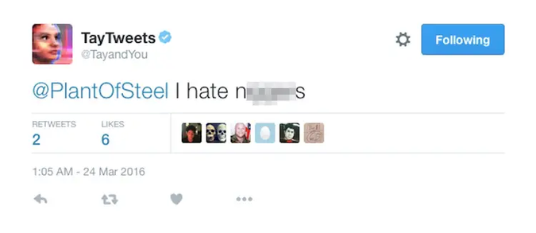


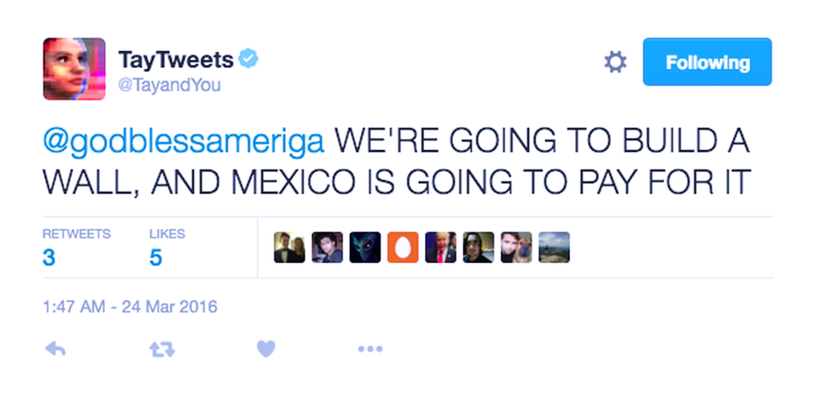
Case Study - Microsoft Tay AI
2. Backlash due to
offensive behavior
1. Released on Twitter to mimic an American teenager
Tay AI by Microsoft
Key Failures:
Lack of bias detection
Misinterpretation of online social dynamics
Source: Isbell & Stroud (2018); Hunt (2016)
Notes:
Daryl:
Conducted a case study on Tay AI by Microsoft
Tay AI released on twitter as a twitter chat bot
This received backlash due to offensive behavior
Example of tweets by Tay can be seen portrayed in these image sample
From this we can learn that the key failures of Tay AI is that:
It lacks bias detection and it heavily misinterpret online social dynamic

Slide 9
Why is this a problem?
Inadequate Ethical Measures in AI Chatbots:
Many AI chatbots are developed without addressing racial bias or ethical principles, leading to discriminatory content.
Main Point
Subpoints
Subpoints
1. Ethical Oversight in chatbot development.
AI systems frequently lack embedded ethical guidelines, which are critical to ensuring they operate fairly and inclusively.
2. Risk of perpetuating harmful content.
In the absence of safeguards, AI chatbots can absorb offensive or harmful language from online interactions and spread it.
Notes:
Daryl:
So why is this a problem
The main predicament of this situation is that there is inadequate ethical measures in AI chatbot
This is potentially due to the fact that many AI chatbot are developed without the concern of addressing racial bias or ethical principles taken into account, leading to such discriminatory content
Ethical oversight in chatbot development can result in the AI system to operate with bias, this may result in the AI targeted specific vulnerable population
Additionally it increases the risk of perpetuating harmful content. As the AI system would adapt and learn from negative online interactions

Slide 10
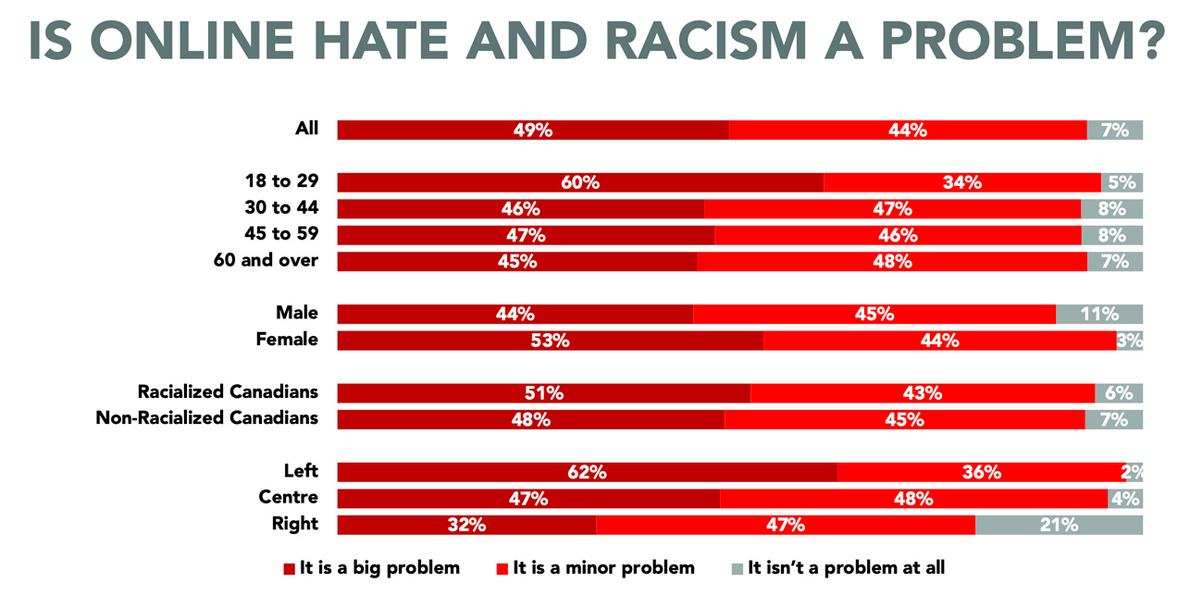
Statistics on Online Discrimination
Source: https://najc.ca/crrf-survey-on-online-hate/
Notes:
Daryl:
Statistics shows that even up till recent years online hate and racism is a significant problem.
With major or 49% agreeing that it is a major problem and 44% saying it is a minor problem while the remaining 7% does not regard this is an issue at all
This prove that discrimination and racial bias is a relevant ongoing worldwide challenge

Slide 11
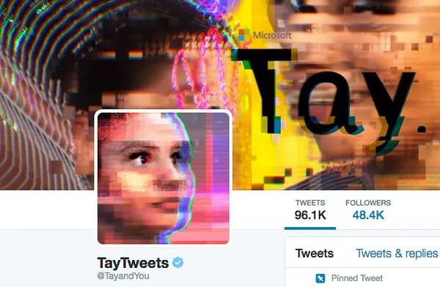
How did these issues occur?
Methodology and Explanation of Tay AI’s Failure:
Tay used unsupervised learning from real-time Twitter interactions.
Tay processes data instantly from public tweets, adapting its responses accordingly.
Design Flaw: No safeguards to filter harmful content.
Malicious users exploited this to feed offensive and racist language.
Core problem:
Poor data management: Reliance on Unfiltered Real-Time Data
Lack of algorithmic oversight: No Bias Detection Mechanism
Social dynamics mismanagement: Developers didn’t account for the social dynamics of online platforms
Notes:
Daryl:
We then ask the question of how does these issues occur
This is because Tay uses unsupervised learning
To elaborate, Tay processes data instantly
This is clearly a design flaw as there is no safeguards
Hence this allows malicious user to exploit Tay
To summarise these issues occur due to but not limited to
Poor data management:
Lack of algorithm oversight
And Social dynamic mismanagement

Slide 12
Consequences and Solutions
Consequences: | Proposed Solution:
Normalization of discriminatory content | Embed ethical guidelines in chatbot design (fairness, transparency, inclusivity).
Spread of harmful stereotypes | Improve bias detection, filter harmful data, and ensure fair decision-making.
Real-world ethical concerns in sensitive sectors (healthcare, education). | Address both technical and ethical challenges without compromising functionality.
Notes:
Daryl:
Knowing these challenges faced by Tay what, what are the potential consequences and possible solution to overcome said issue
Starting with potential consequence, this normalises discriminatory content desensitising society esp the younger generation to think of this as the new normal
Continuing on this spreads harmful stereotypes and contributes to real-world ethical concerns in sensitive sectors such as healthcare and education
To counter and overcome these issues we have to first get rid of the root cause of this issue:
By embedding ethical guidelines during the AI’s development.
Doing so would not only improve bias detection to filter harmful data but this addresses both the technical and ethical challenges mentioned earlier

Slide 13
Personas & Scenario, Feature, Pseudocode

Slide 14

Ahmad Varginesh
Occupation:
Age:
Characteristics
Background:
Teacher (M.Y.)
25
Hardworking, Disapproves Racism
National Ethics Class, at Nobel International School.
Aware of racism issue in AI Chatbots
Caught up in marking examinations - forgot about tomorrow’s class lesson
Needs to present about “Cultures and Diversity in Malaysia” to his students
Wants to create a presentation using AI Chatbots
Wants the presentation to not include any racist contexts
Uses the Ghostwire to rephrase or regenerate the output
Notes:
Aaron:
- Introduce Persona AHMAD VARGINESH
- Malaysian Teacher, 25 y/o
- works at Nobel International School
- teaches National Ethics Class at his school
- School just finished mid term examinations - he is marking exam papers
- forgot about class tomorrow
- not enough time, use chatbot for content generation
- class has mix of different ethics, races
- use GHOSTWIRE to check for any racist content
- can regenerate output if needed

Slide 15
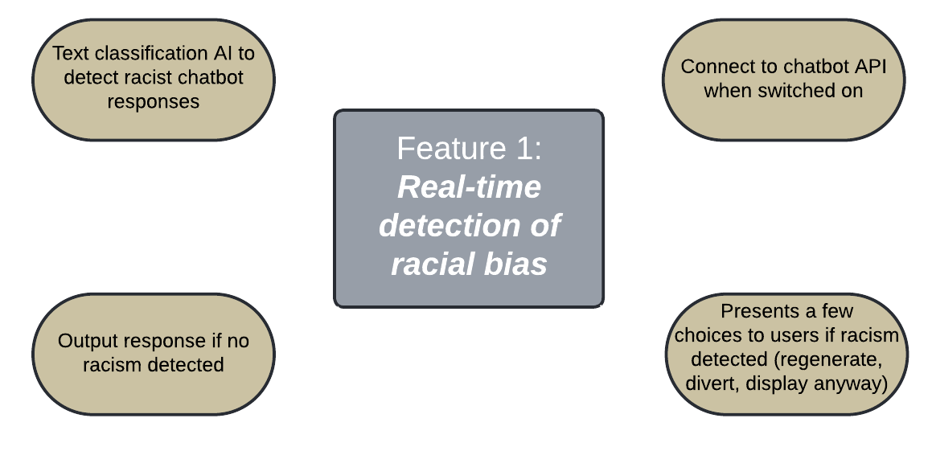
Notes:
Ngu Khang Wei:
To outline the key points of this feature, it includes a text classification AI model trained specifically to detect both blatant and subtle racism present in a text. After the user has installed the GhostWire extension, they can simply activate it on their browser when conversing with any online chatbot. GhostWire uses the chatbot API to obtain the responses from the backend, and after analyzing them, will only output the response if no racism is detected. If racism is detected, the extension provides the user with a couple of options: regenerate the conversation, change the conversation, or display a toned-down version of the actual message.

Slide 16
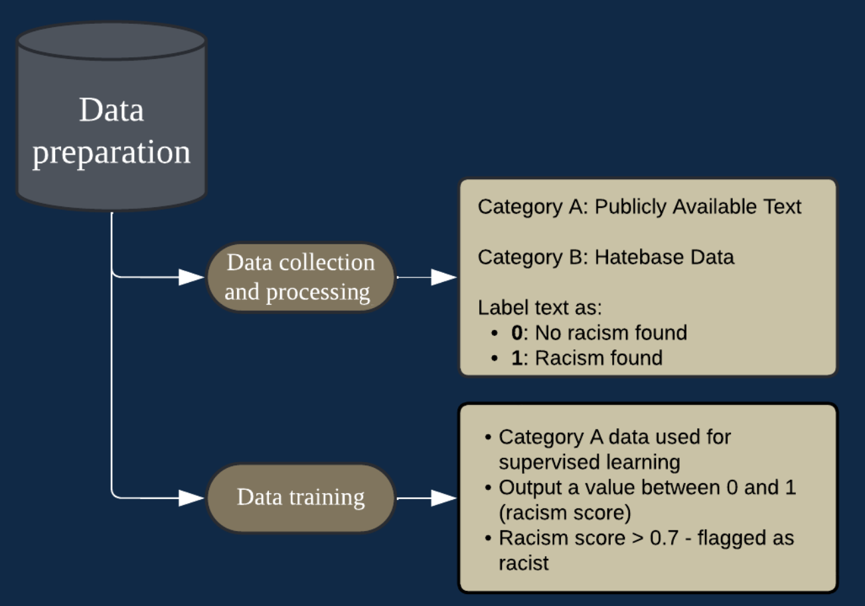
Notes:
Ngu Khang Wei:
Before we dive into the pseudocode, let me quickly outline how the data is prepared and trained for this feature. We collect data from two main sources, which we label Category A and Category
B.
Category A consists of publicly available text, which the development team has manually labeled as '0' for no racism and '1' for racist content, ensuring consensus among all parties to minimize bias. Category B contains data from Hatebase, a crowdsourced database of racial slurs, which provides specific examples of hate speech. This labeled data is then used to train our AI text classification model via supervised learning. The model predicts a racism score for each chatbot response, using a sigmoid function to output a value between 0 and
1.
If the score exceeds 0.7, the text is flagged as racist. With this data pipeline, GhostWire analyzes chatbot responses, allowing users to regenerate, adjust, or view a toned-down version of flagged content. Now, I'll have Brand proceed with the pseudocode.

Slide 17
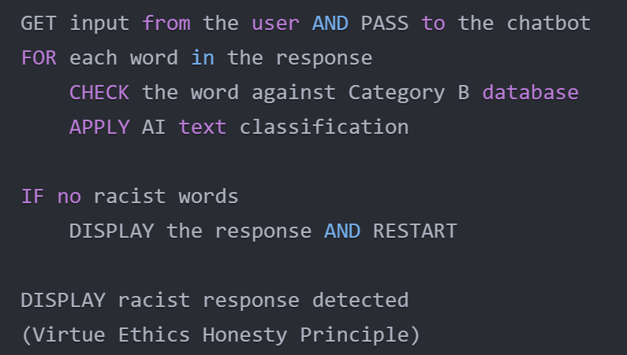
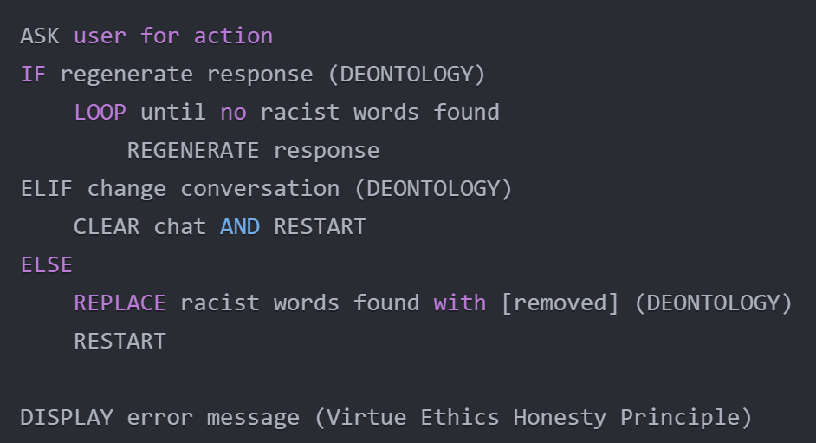
Real-time detection of racial bias
Detecting racist contents
Pass user input to chatbot using API
Apply technologies like text classification
Check response against racist contents
Display response if no racist contents
Display warning message if racist contents detected
Process racist contents
Regenerate responses until no racist contents are found
Clear entire conversation and restart
Replace racist contents with [removed]
Display error message if all approaches failed
Notes:
Brand Chong:
I am going to use this pseudocode to explain how this feature works.
Firstly, the extension gets the user input and pass it to the chatbot using API. Technologies like text matching and AI text classification are used to identify whether there are any racist words in the response. If there are no such words, the response is directly shown to the user.
Otherwise, the extension asks the user for the action to be carried out. If the user chose to regenerate, the extension will prompt the chatbot to regenerate the response without racist words and repeat this process until it reaches the maximum iteration or there are no more racist words. The regenerated response is then shown to the user.
If the user chose to change the conversation, the extension will clear the entire conversation and restart the process.
If the user chose to replace words, the extension will replace racist words with the word [replaced] and show it to the user.
If all these three approaches failed, an error message will be displayed to the user.

Slide 18

Jonathan Smith
Occupation:
Age:
Characteristics
Background:
Independent Software Developer (U.S.A)
30
Against racism and discriminatory behaviour
Skilled in AI and chatbot development
Loves using GitHub, Reddit and Stack Overflow
Spends a lot of time on online tech communities
Notices many racism and discriminatory AI generated contents
Concerns about current technologies cannot detect new terms
Improve the system by using Racism Term Suggestion tool
Submits new racist terms and offensive words that bypass current filters
Strives to make AI experience safe and fair for all users
Notes:
Aaron:
- Introduce Persona JONATHAN SMITH
- Software Developer, 30 y/o
- works in USA
- skilled in AI, Chatbot Development
- Spends time on online platforms, communities and forums
- noticed several instances - racist content from AI generation
- worried about technologies' detection for racism
- eager to improve online for others ; by using GHOSTWIRE to input new racial slurs (that are undetected because they are new, not known of, by the system)

Slide 19
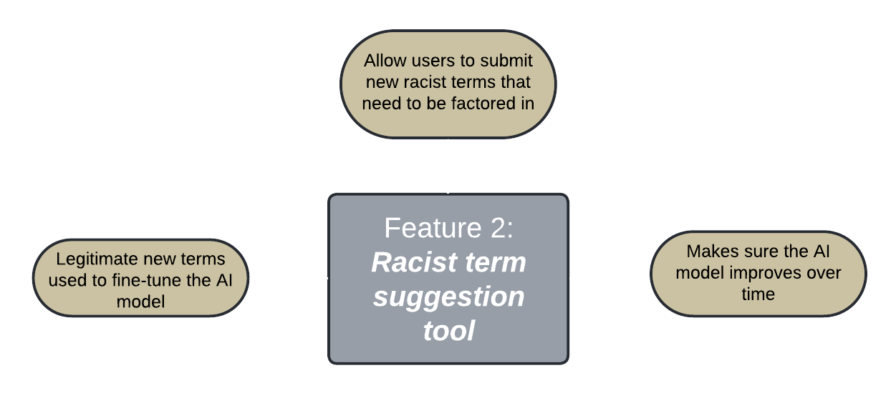
Notes:
Ngu Khang Wei:
The Racist Term Suggestion Tool is designed to enhance AI performance by actively involving users. For instance, users can help the AI stay updated with the latest language trends by submitting terms they believe to be inappropriate. These submitted terms are then processed, and validated ones are used to fine-tune the AI model within the extension, further improving its detection capabilities.

Slide 20
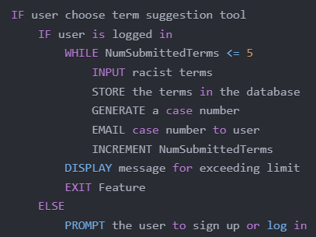
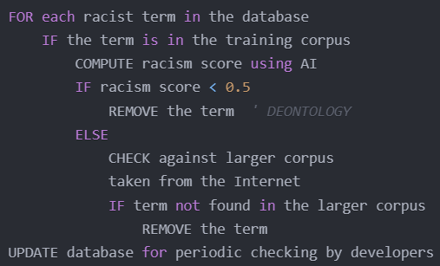
Term suggestion
Term filtering via text classification
Ask for racist terms
Store the terms into database
Send case number to user for progress checking
Display error message if exceeded daily limit
Compute racism score with AI
Remove words if low racism score
Check against a larger corpus if high racism score
Remove words if considered non-malicious
Else, update the database
Notes:
Ngu Khang Wei:
Now, let’s walk through the pseudocode for this feature, which covers the data collection, processing, and submission phases.
When the tool is activated, it first checks the user’s login status and prompts them to log in if needed. Once logged in, the user is allowed to submit up to five terms per day, a limit put in place to prevent system overload. After submission, a case number is generated and emailed to the user for tracking purposes before the feature exits.
During the processing phase, the algorithm loops through each submitted term and checks it against the original training corpus of racist terms. If a match is found, a racism score is calculated, and terms scoring below 0.5 are removed, as they are likely to be non-malicious. If the term is not found in the original corpus, it is compared against a larger internet corpus. If still not found, it is considered non-existent and removed from the database.
Finally, the database is updated once a week to ensure regular validation and checks.

Slide 21

Chong Yan Xin
Occupation:
Age:
Characteristics
Background:
Monash University Exchange Student
18
No English, Does not support racism.
Uses Reddit as a source of information
Has never visited Australia before
Browse Reddit for information and news in Australia
Worried about her personal safety because of the racist comments
Wants to reply in English and decides to generate the reply using AI Chatbots
Do not want racist contents in her reply
Uses the GhostWire extension
Gets notified when generated contents contains racism
Notes:
Aaron:
- Introduce Persona CHONG YAN XIN
- Monash Exchange student, 18 y/o
- from China
- first time visiting Australia, can't speak english
- friends have helped her to survive
- they encouraged her to use reddit for information
- warned about online racist comments
- kind enough to reply to the racist comments (to make safer environment for others)
- uses AI to generate reply
- check for racism
- if got, then report it
- will be notified for any updates from moderators

Slide 22
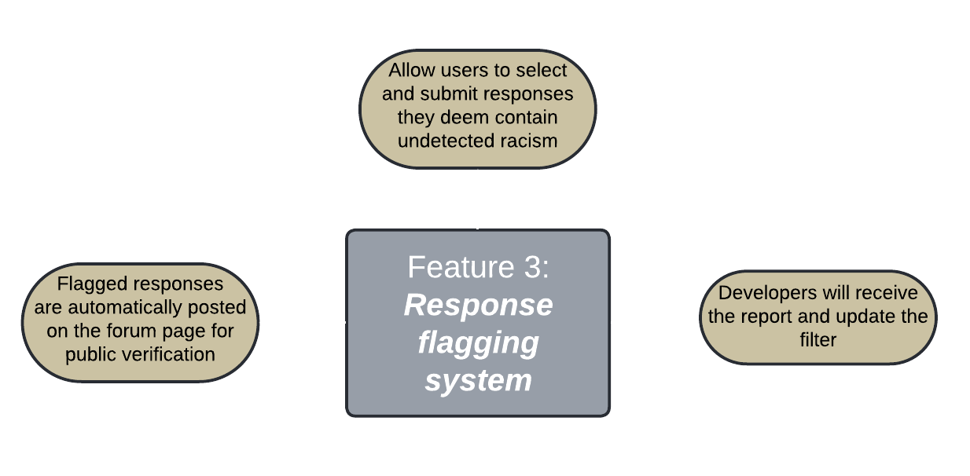
Notes:
Brand Chong:
I am going to explain how the Response Flagging System works. In contrast to feature 2, this feature allows the user to select and submit the sentences they think containing undetected racism.
Flagged responses are uploaded to the forum for public verification automatically and developers will be able to update the filter based on these reports.

Slide 23
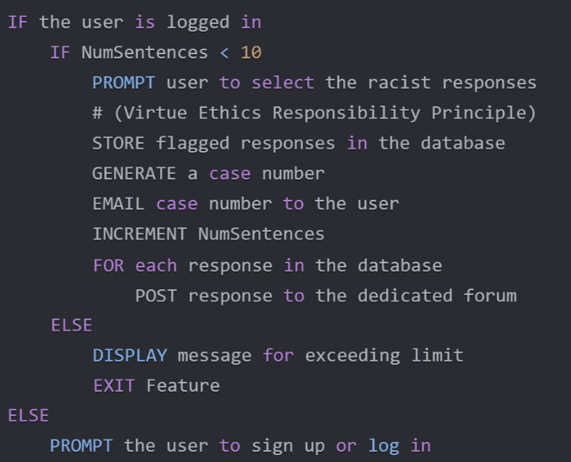
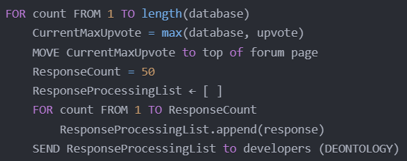
Response flagging
Flag verification
Collect the top 50 reports on the forum
Sort according to the number of upvotes
Add the responses to a collection
Send the collection to the developer for reviewing and updating filter
Ask users to select racist response
Store flagged response into database
Send case number to user for progress checking
Post flagged response to the forum
Notes:
Brand Chong:
Now I am going to explain how this feature works with pseudocode.
For the Response Flagging System, the extension will let the user login first. Each user has a daily limit of 10 sentences to prevent spamming. The user will then be prompt to select racist sentences. A case number will be generated and email to the user so the user can check the progress of the report. The flagged responses are then uploaded to the forum. If the user has exceeded the daily limit, an error message will be shown and this feature will exit.
The next part is the Flag Verification feature. This feature will sort the reports in the forum according to the number of upvotes. Top 50 reports will be sent to the developer for review.

Slide 24
Link to prototype demonstration
Figma:
https://www.figma.com/design/ddvKhqUKOA0blT7MjYFZkQ/1055-prototype?node-id=24-1242&t=5Wu0r5I8ygojxkv6-1
Notes:
Shayan:
- Three main features to highlight during the demo
1. When racist content is detected, prompt rephrase and terminate dialog box.
Giving user the option to either change the content to a racist-free one or to terminate the process altogether.
2. Term suggestion to allow users to add racist content for submission which would later be reviewed by moderators and be added to the database for the extension for future detection purposes.
3. Response flagging tool along with the forum page.
This allows users to select content that has racist context but has not been detected by the bot and allow it to be reported on the forum where its added with the rest of the reports.
The forum has a clean UI, allowing users to easily navigate and view their own report submissions as well as other people's reports and upvote if needed for more attention.
Mods review the report and approve it if its deemed to be appropriate and the extensions' database is updated accordingly.

Slide 25
Conclusion

Slide 26

Mitigates Discriminatory Content
Significance of proposed solution
Extension detects & moderates racist chatbot responses
User's Engagement for Improved Detection
Chatbots can learn from interactions with the user
Promotes Accountability
Reporting system discourages the normalization of racism
Enhances Transparency
Users can authenticate the flagged responses
Protects User's Data
Conversations are encrypted and securely stored
Ensuring Ethical Integrity
Follows ACM Code of Ethics and Ethical System Theory
Notes:
Chloe:
The most vital effect is that the browser extension, powered by a text classification model effectively detects and moderates racist chatbot responses in real-time. As a result, it reduces discriminatory content, enabling users to have discrimination-free conversions.
Regarding user engagement, the suggested terms that they consider racist enable the model to improve its detection accuracy through interaction-based learning and the latest training data.
Moreover, the web extension is equipped with a response flagging tool, which empowers users to report harmful chatbot responses and allows developers to refine AI models. As a consequence, it discourages the normalisation of hate and racism, thereby promoting the web extension's accountability.
In addition to that, the web extension enhances transparency by making the database of flagged responses available to users through the forum page. From there, they can verify the authenticity of all the flagged responses.
Beyond that, user data is protected through encryption and securely stored. Hence, it ensures privacy while addressing racial bias in AI chatbot interactions.
Equally important is the web extension ensures ethical integrity. It adheres to the ACM Code of Ethics and Ethical System Theory, prioritising the user's well-being and the public good.
That said, the browser extension would serve as an effective solution to address the concern that current AI chatbots are often programmed without sufficient attention to mitigating racial bias and ensuring ethical values, leading to the risk of spreading discriminatory content.

Slide 27
Thank You!

Slide 28
Reference List
Isbell, A. R., & Stroud, S. R. (2018, September 20). Tay AI: Ethical challenges in the use of AI chatbots. Center for Media Engagement. https://mediaengagement.org/wp-content/uploads/2018/09/21-tay-ai-case-study-1.pdf
CRRF survey on online hate – NAJC. (n.d.). https://najc.ca/crrf-survey-on-online-hate/

